Slide 1
Baldwin Traffic Simulation Model for the
9th Elementary School Building Committee
John Doggett TMM P13
4/25/2017

Slide 2
Three Questions
How does the traffic affect getting the students to school?
How does the school traffic affect the neighborhood?
Does the drop-off design work effectively?

Slide 3
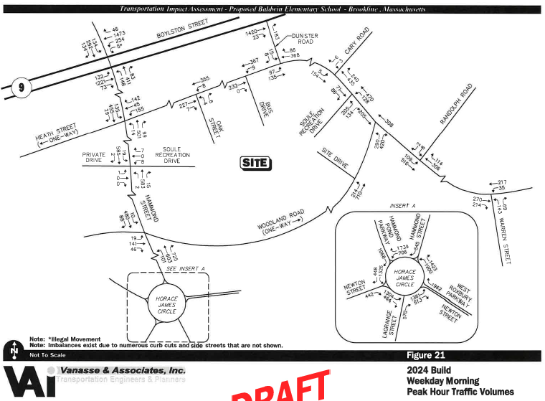
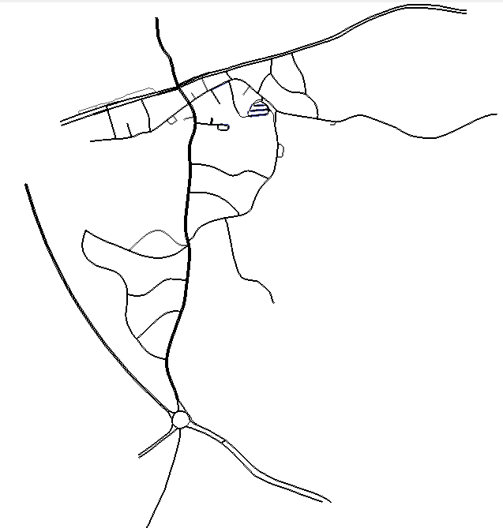
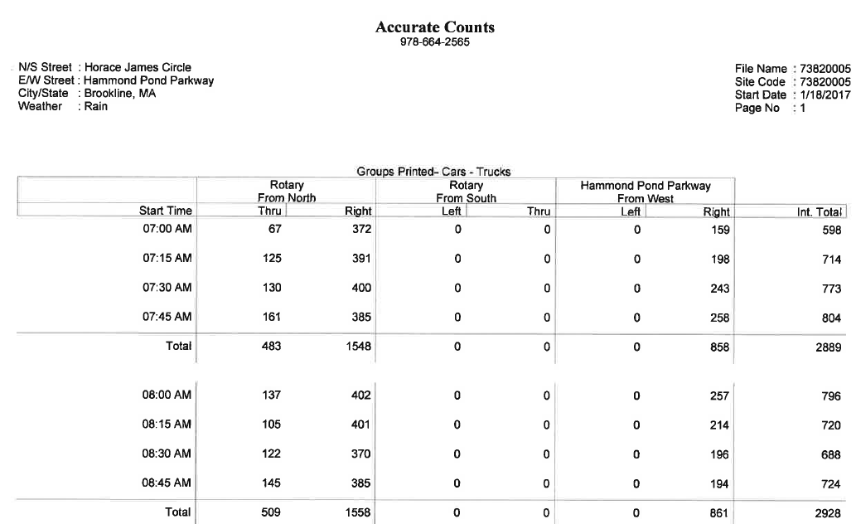
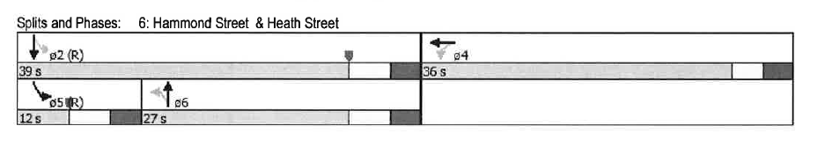
Simulation Model
Route 9
Parking Lot
Heath St
Soule
Woodland
Hammond St
Peak hour: 7:15am – 8:15am
with 15 minute traffic variations
and recommended traffic signal phasing
Horace James Circle

Slide 4
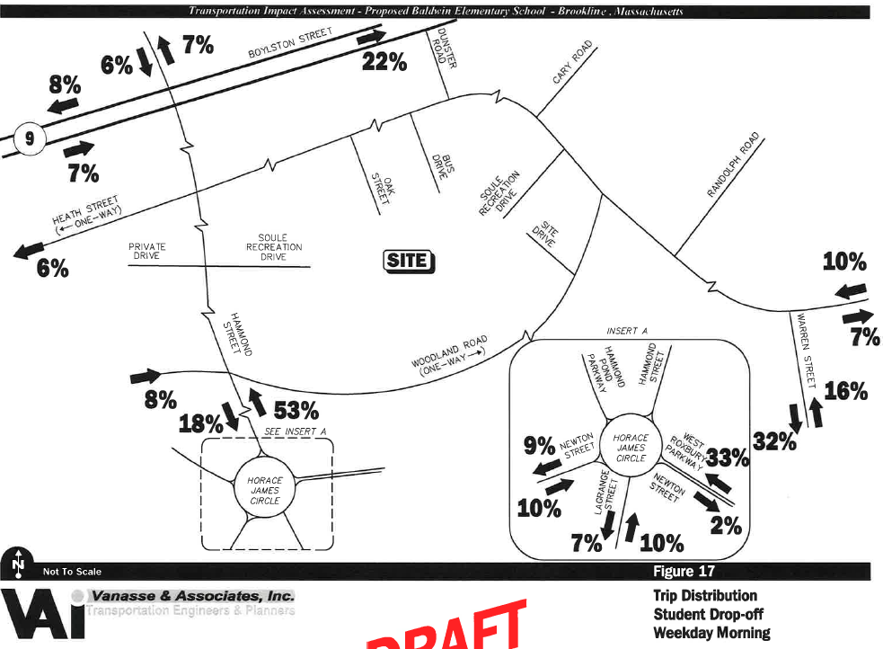
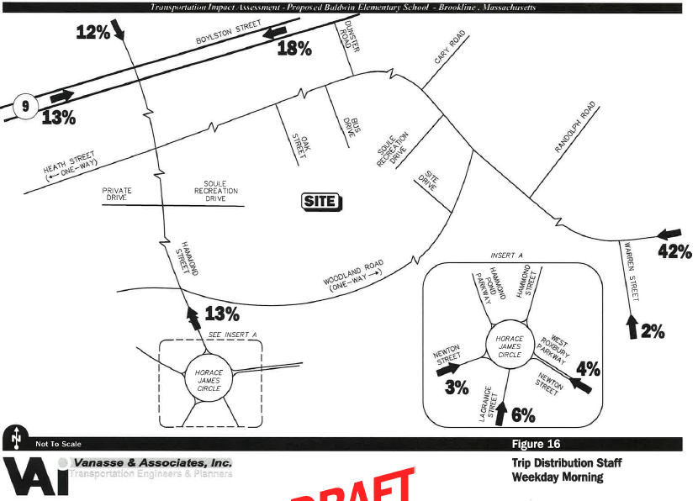
Key Assumptions
252 Student Trips:
69% from South
10% from East
15% from West
6% from North
88 Staff Trips:
15% from South
60% from East
13% from West
12% from North

Slide 5
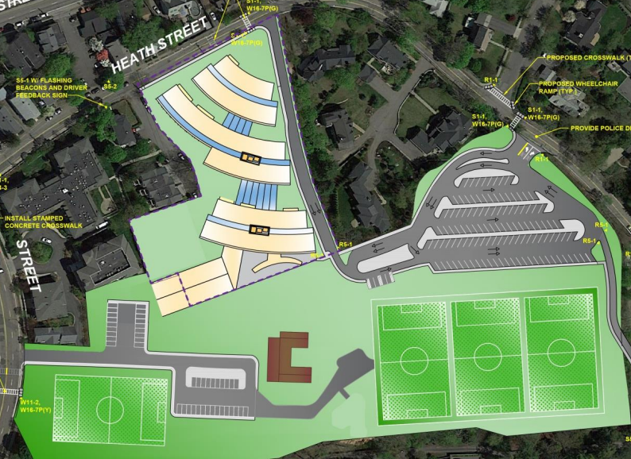
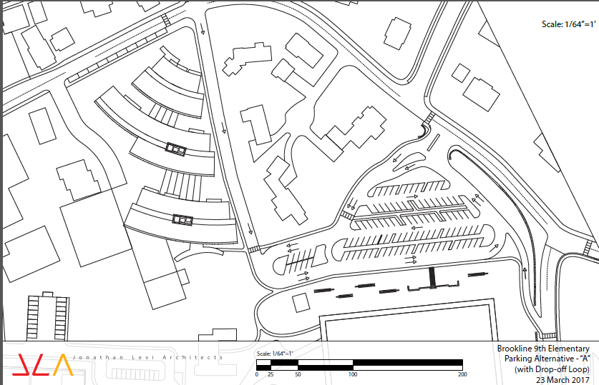
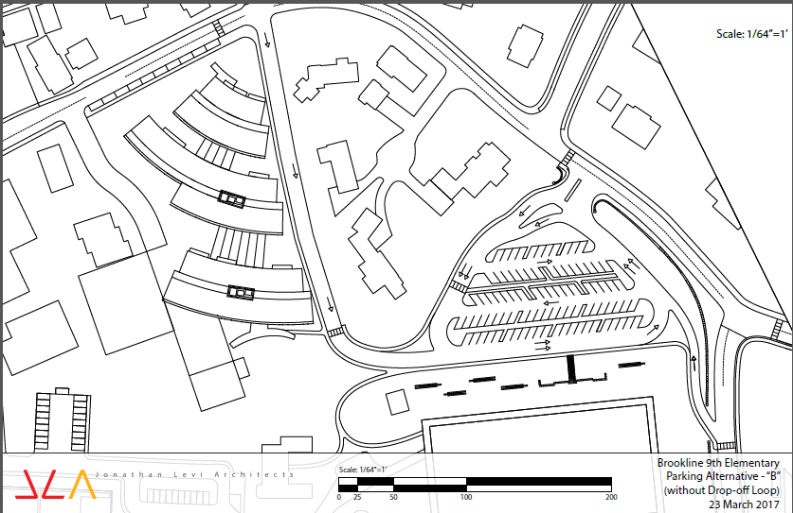
Does the drop-off design work effectively?
Initial design
Option A
Option B
Drop-off Zones
Drop-off Zones
Drop-off Zones

Slide 6
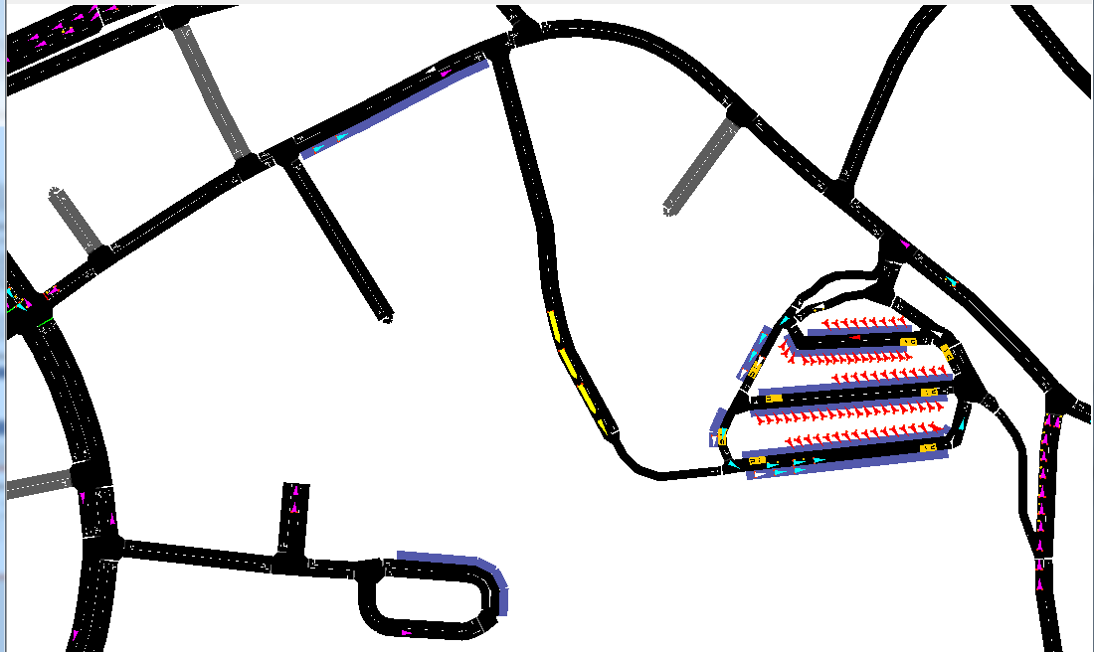
Model: Annotated Screen Shot
Rte 9
Heath Street
Heath
Student
Aqua
Baldwin
Drop-off
Staff
Red
General Traffic
Purple
School Buses
Yellow
Hammond Street
Woodland Road
Woodland
Student White
Drop-off

Slide 7
Model Runs
Parking Lot and Drop-off
Horace James Circle

Slide 8
Model Runs
Parking Lot and Drop-off
Horace James Circle

Slide 9
Model Run Results
Driscoll drop-off observation
Baldwin parents emulate Driscoll
Baldwin parents adjust for traffic conditions
Driscoll drop-off compared to potential Baldwin drop-off

Slide 10
Driscoll Arrival Distribution Observation
81 Vehicles (~117 Students)
22%
77%
1%
26 Students
90 Students
1 Student

Slide 11
Baldwin Parents Follow Driscoll Arrival Distribution:
Vehicle Arrival in 5 minute Intervals
Baldwin
Driscoll
17%
38%
45%
64 Students
138 Students
164 Students

Slide 12
Baldwin Arrival Distribution to get all Students to School on Time
252 Vehicles (365 Students)
68%
32%
0%
247 Students
119 Students
0 Students

Slide 13
To Get Students to School:
Baldwin Arrivals need to arrive 20-30 Minutes prior to Driscoll
Baldwin
Driscoll

Slide 14
Model Result Observations
Parking drop-off design B can handle 10+ vehicles a minute
  8 drop-off (30ft) slots for vehicles on Heath St add capacity and temporary parking
  Temporary parking issue needs more discussion and modeling
Traffic:
  Retiming of lights and improved drop-off design resulted in reasonable queues in Hammond, Heath and Woodland
  Horace James Circle is a gating factor
Many students will have to arrive 20-30 mins earlier than would be normally expected for other Brookline schools
Accommodation/Programs need to be considered for 250+ students who arrive early

